Slide 1


MRO PRO Launch – Line Maintenance Worldwide
August 2025
Confidential – British Airways

Slide 2
AGENDA
1
Why MRO PRO?
5
Training & Support
2
What is MRO PRO?
6
BCP – If MRO PRO Goes Down
3
What’s Changing for You
7
What Happens Next?
4
MRO PRO SharePoint Hub
8
Questions and Feedback
Confidential – British Airways

Slide 3

Why MRO PRO?
Context behind the transformation – industry challenges, inefficiencies, and the vision for LMWW.
Confidential – British Airways

Slide 4
🛑 Problem
Paper-based, manual processes slow us down.
Work order errors → lost revenue & compliance risks.
No global standard — each station works differently.
MRO PRO brings a single digital system for all Line Maintenance.
Built around Work Orders — connecting maintenance, billing, and compliance.
Fully integrated with stores, tooling, and customer contracts.
💡 Solution
🌍 Outcome
Faster, smarter, and consistent operations worldwide.
Data-driven decisions with clear traceability.
Fewer errors. More revenue. Better service.

Slide 5

What is MRO PRO?
Overview of the platform: work orders, compliance, billing, tooling, and integrations.
Confidential – British Airways

Slide 6
🔧 Work Orders
Create, update, and close aircraft maintenance events
Capture all tasks — planned or ad hoc
Audit-ready recordkeeping
Integrated Tech Log scanning and signature tracking
✅ Compliance
Links work done to customer contracts
Tracks man-hours, delays, and consumables
💰 Billing & Invoicing
Connects to Tool Control and Stores systems
Ensures traceability and stock accuracy
🛠 Tooling & Stores

Slide 7

A solution for the company, that’s really a solution for you!
Confidential – British Airways

Slide 8

What’s Changing for You?
How daily work will be impacted — from work order entry to tech log scanning to BCP.
Confidential – British Airways

Slide 9
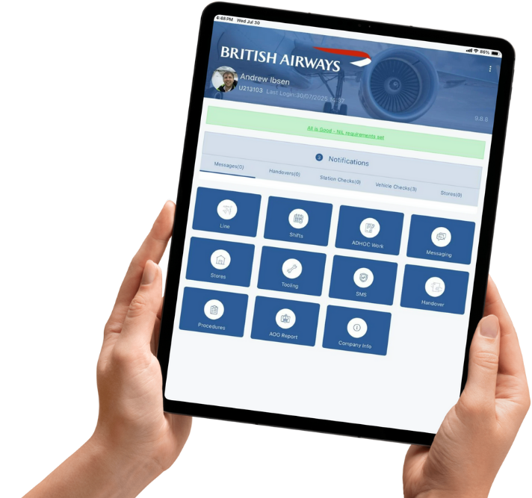
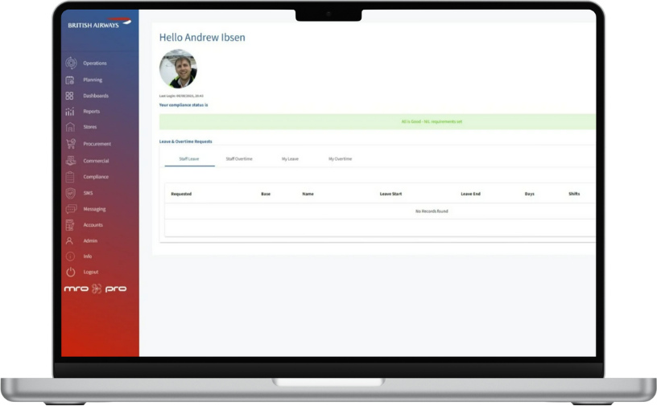
Frontend x Backend

Slide 10
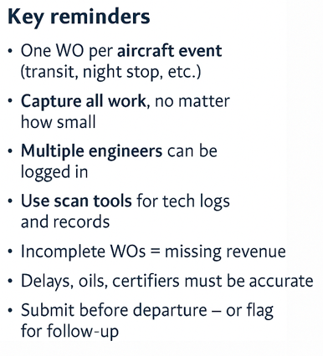
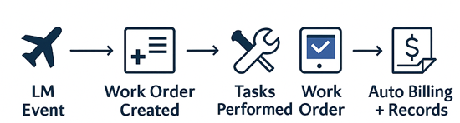
Work Orders: The Core of MRO PRO
Confidential – British Airways

Slide 11

MRO PRO SharePoint Hub
One central hub for everything you need.
Confidential – British Airways

Slide 12
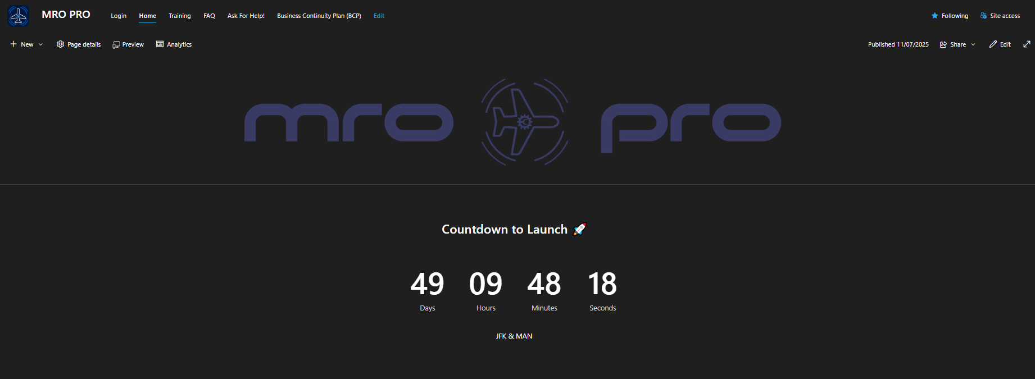
Confidential – British Airways

Slide 13
🏠 Home Page Overview – MRO PRO SharePoint Hub
The Home Page serves as the central landing space for all things MRO PRO. It is designed to keep users informed, engaged, and connected.
🔔 Announcement Zone – This will host key updates, rollout milestones, reminders, and urgent notices for all engineers and managers.
⏳ Countdown Timer – A visual cue marking the next key event (e.g., go-live, training deadline, phase launch).
📍 Navigation Gateway – From here, users can jump to training pages, FAQs, ticket submission forms, and Business Continuity Plans (BCP).
🧭 Think of it as your mission control – the first place to check when logging in for any MRO PRO update or guidance.

Slide 14
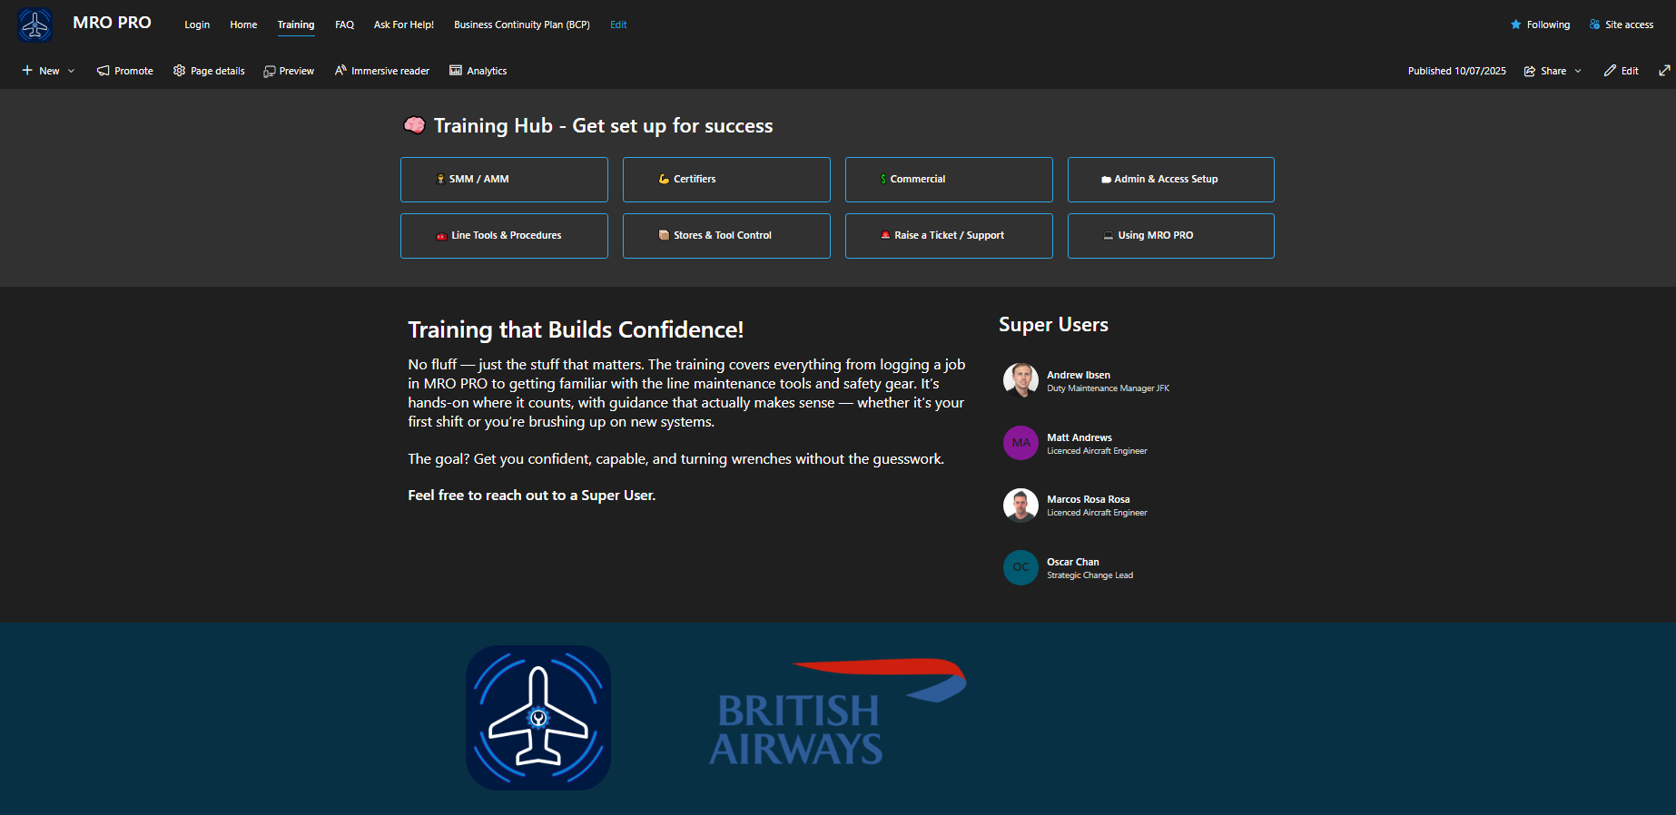

Slide 15
🎓 Training Hub – Get Set Up for Success
The Training Hub is your go-to space for all training resources related to MRO PRO. It’s designed to empower engineers, managers, and support staff with everything they need to succeed.
✅ Role-Based Training Filtered training pathways tailored for SMMs, AMMs, Certifiers, Commercial and Admin roles.
📺 Demo Videos & Guides Easy-to-follow tutorials, including how to create work orders, scan TLPs, and submit records.
📂 Read & Sign Section Important documents and sign-offs to meet compliance requirements.
🧠 Quick Tips Common mistakes to avoid, FAQ, and troubleshooting guides — all in one place.
🧭 Think of it as your onboarding companion and daily support kit for using MRO PRO the right way.

Slide 16
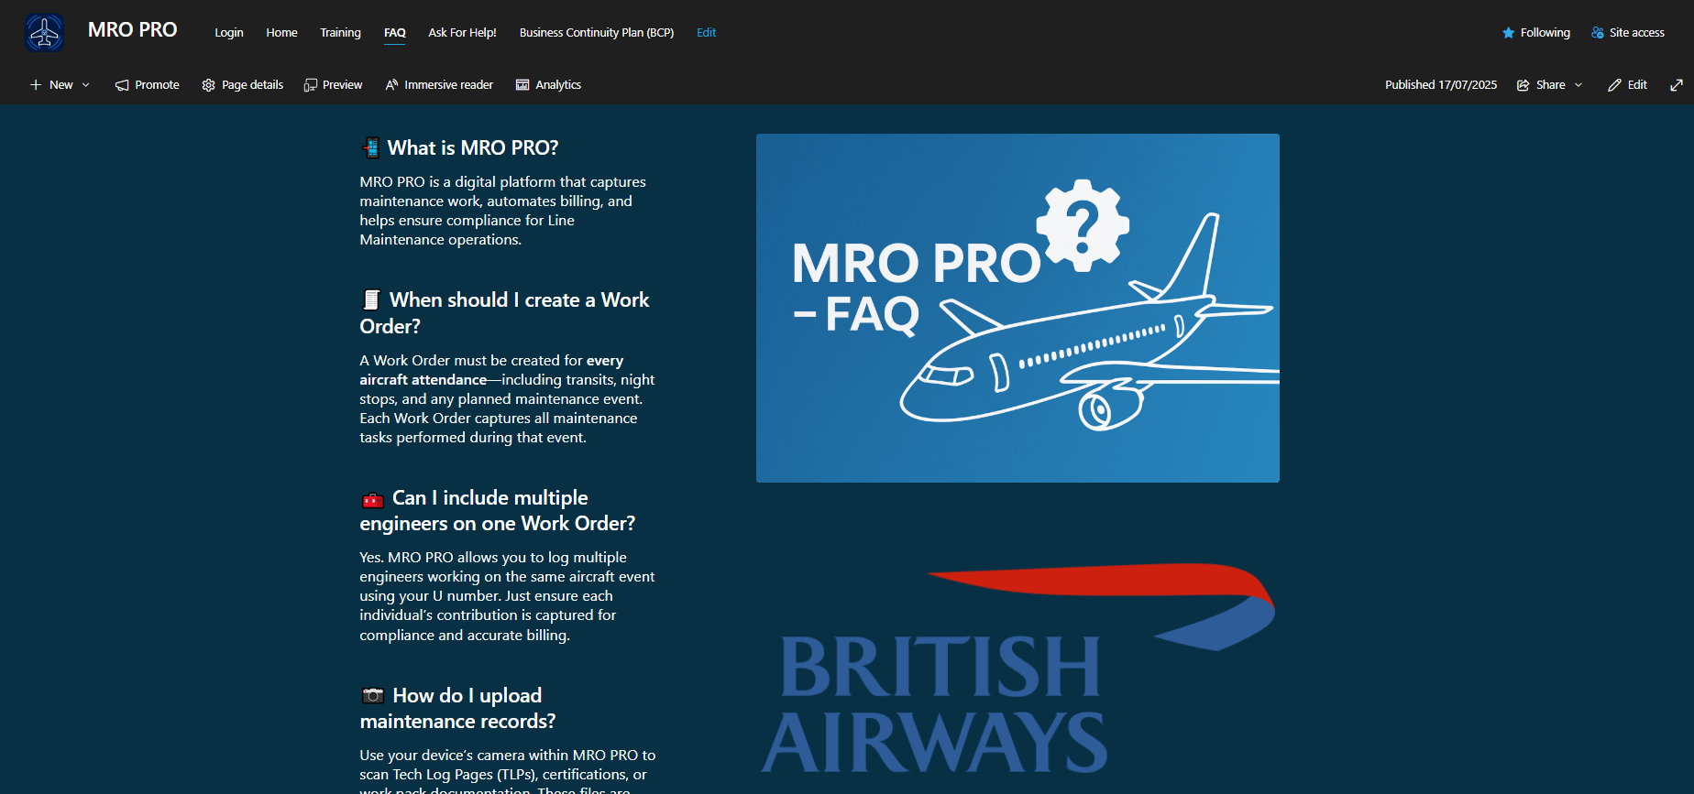

Slide 17
❓ MRO PRO – Frequently Asked Questions
The FAQ section is a self-service resource to help users find quick answers to common MRO PRO questions — saving time and reducing dependency on support.
💡 Searchable Knowledge Base Find how-to guides, technical troubleshooting, and admin support topics
👷‍♂️ Engineer-Focused Includes certifier-specific entries on submitting work orders, scanning TLPs, and handling airline-specific workflows.
🔁 Updated Regularly Reflects the latest feedback from stations, super users, and system updates.
🚀 Access Anytime Embedded into the SharePoint Hub — accessible from any device.
📌 Check here first before raising a ticket — the answer might already be waiting for you!

Slide 18
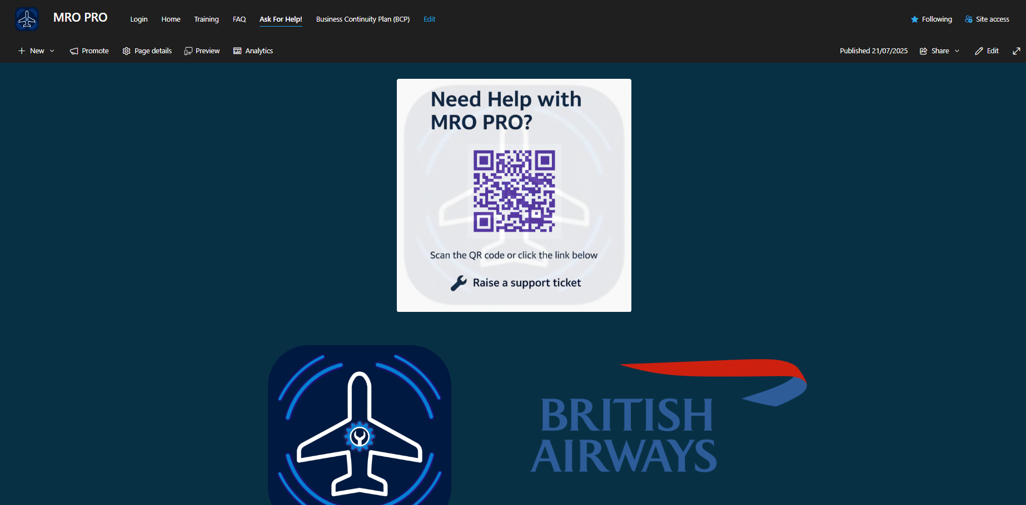

Slide 19
🆘 Ask for Help – Raise a Support Ticket
The Ask for Help page ensures engineers and support staff can quickly raise issues, report bugs, or get answers when they need help using MRO PRO.
🔧 QR Code Access Scan the code or click the link to instantly open the ticket form on any device.
📥 Simple Support Ticket Submit an issue in just a few taps — whether it’s a system bug, training query, or a work order problem.
⏱ Faster Response Time Routed directly to superusers or MRO PRO support for faster resolution and follow-up.
🔄 Integrated Escalation Flow If your manager can’t resolve the issue, this is the formal path to escalate.
💬 Check the FAQ first — but if you’re still stuck, don’t hesitate to raise a ticket.

Slide 20
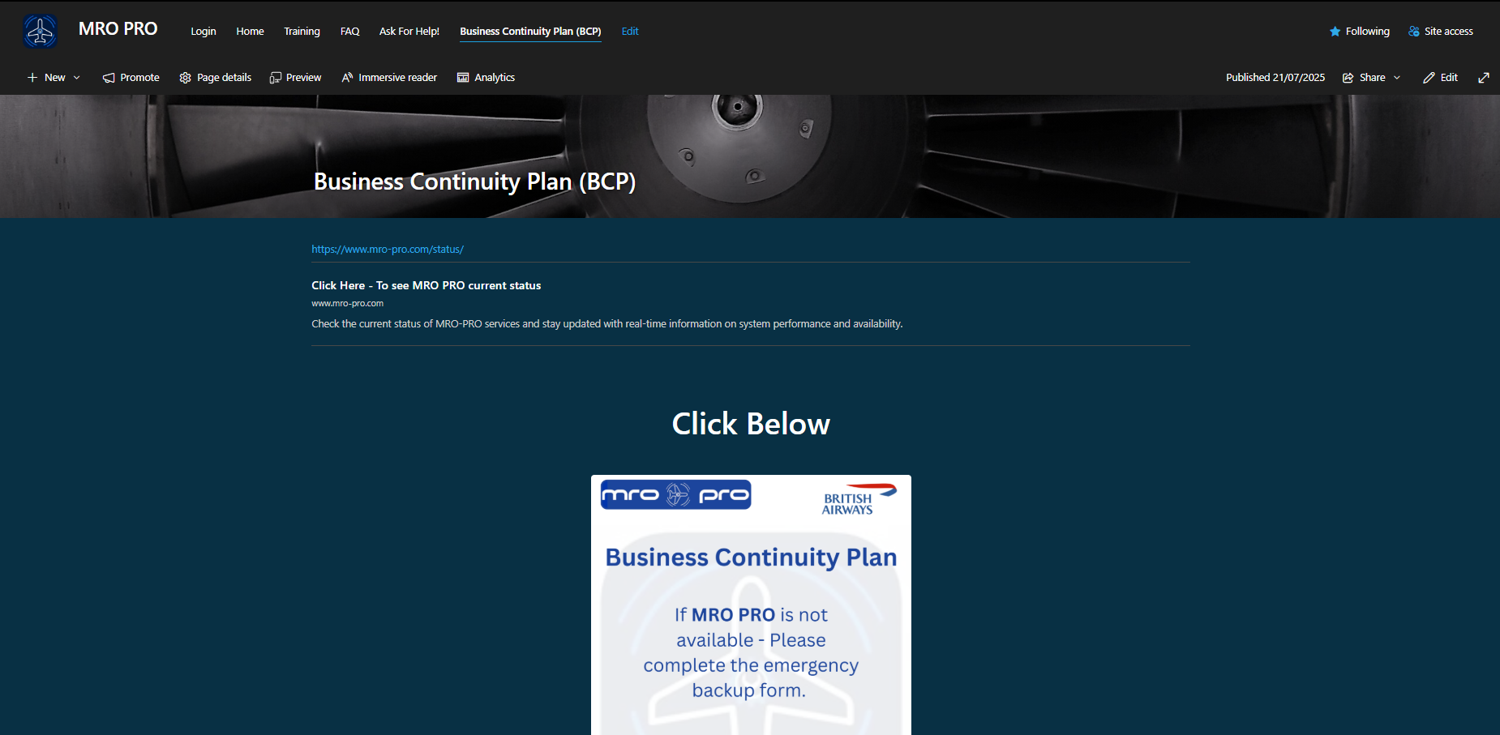

Slide 21
🛠 Business Continuity Plan – What to Do if MRO PRO Goes Down
The BCP page provides a clear, immediate action path when MRO PRO becomes unavailable, ensuring continuity and compliance during outages.
🌐 Live Status Link Check real-time system availability via mro-pro.com/status
📄 Emergency Backup Form If MRO PRO is down, fill out the emergency form to record maintenance activity and protect audit trails.
✅ Maintain Compliance Forms are saved, uploaded, and linked back to the Work Order once the system is restored.🔄 Integrated 🔁 Seamless Recovery Backup entries ensure no data is lost, and business functions resume without disruption.
🔒 BCP isn’t just a fallback — it’s your safety net. Make sure your team knows what to do.

Slide 22


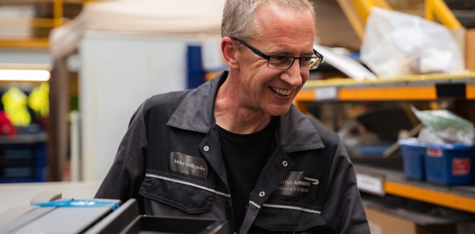
MRO PRO – Powered by You
Every scan, every tap, every submission Brings us closer to world-class line maintenance.
British Airways Engineering – Proudly Delivering.

